Slide 1
Data Visualization

Slide 2

Good Decisions Are Based On An Accurate Understanding Of Good Data
Good Data
Understanding
Good Decisions
Do you need to be Einstein to make sense of your data?

Slide 3
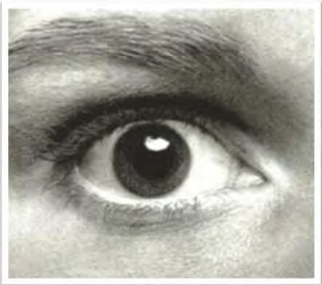
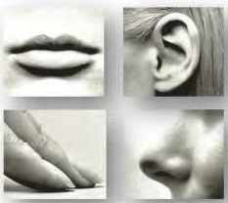
Vision is our most powerful sense!
70%
30%

Slide 4
Types of Data
Data
Categorical
Numerical
Discrete
Continuous
Examples:
Customer ratings
City
(Defined categories or groups)
Examples:
Time
Pressure
(Measured characteristics)
Examples:
Number of Cars owned
Defects per hour
(Counted items)

Slide 5
Benefit of visual representation of data
Communicate complex information concisely and powerfully
Create a “picture” for reasoning about and analyzing quantitative and conceptual information
Makes cognitive processing easier
Provides “content/information rich” view at a glance
Directs attention toward the content rather than methodology
Describe, explore, summarize a set of numbers
Convey a messages about the significance of the data

Slide 6
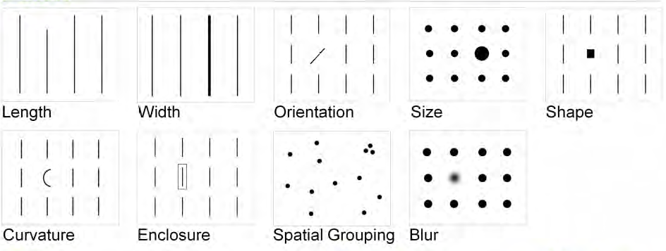
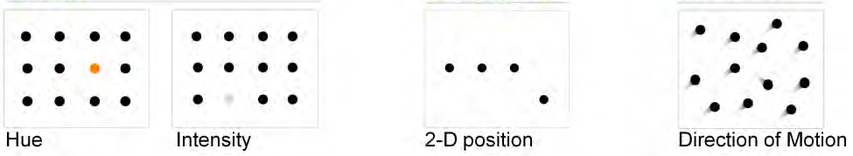
Attributes of Visual perception
Form
Color
Spatial

Slide 7
Four “umbrella” principles of effective visualization
Know purpose
Ensure integrity
Maximize data ink; minimize non-data ink
Show your data; annotate

Slide 8
Knowing your purpose drives all other decisions
Know purpose
Ensure integrity
Maximize data ink; minimize non-data ink
Show your data; annotate
You need to have a purpose statement for every table or graph you create and design the display to serve the purpose…
“My purpose in creating this is ___________________
For example:
My purpose in creating this graph to help the audience see that only a small percentage the patient base are candidates for this specific therapeutic regimen.
Note: a purpose is not necessarily a message.

Slide 9
Ensuring integrity is not just being correct; it also means no distortion
Know purpose
Ensure integrity
Maximize data ink; minimize non-data ink
Show your data; annotate
…not only that the information correct, but that it is presented in a way that doesn’t distort the truth.
Compare these two earnings-per-share graphs…the number are the same, but different scales convey different messages. The graph on the left is deceitful…

Slide 10
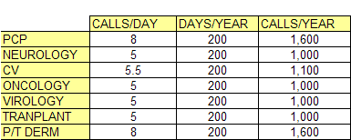
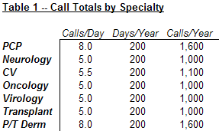
Use the least amount of ink to convey the most amount of information
Know purpose
Ensure integrity
Maximize data ink; minimize non-data ink
Show your data; annotate

Slide 11
Don’t hide data…show it – Use annotations
Know purpose
Ensure integrity
Maximize data ink; minimize non-data ink
Show your data; annotate

Slide 12
Executing your information display is a three-step process
Defining Message
Choosing Form
Creating Design
What am I trying to communicate?
What is the message?
How do I make that message clear at a glance?
Should I use text, table, graph or a diagram?
Or a combination?
What design principles lead to quick cognitive processing and effective communication of the message?

Slide 13
Defining message

Slide 14
Defining Message
Age Group | # AIDS cases
Under 5 | 6,975
5-12 | 2,099
13-19 | 4,428
20-24 | 28,665
25-29 | 10,5060
30-34 | 179,164
35-39 | 182,857
40-44 | 136,145
45-49 | 80,242
50-54 | 42,780
55-59 | 23,280
60-64 | 12,898
Over 65 | 11,555
TOTAL | 816,148
You’ve been asked to produce a data display that provides insight into the population of people with AIDS. To the right is some data about the ages of people with AIDS in the U.S.
Given this data, what is the message that you would like to convey?
Majority of AIDS cases are in the 25-44 age groups
AIDS is most prevalent in the 35-39 age groups

Slide 15
Choosing form

Slide 16
Choosing Form
Below are three ways to display the data to communicate the message from the distribution of AIDS sufferers. What is the most appropriate form?
Age Group | # AIDS cases
Under 5 | 6,975
5-12 | 2,099
13-19 | 4,428
20-24 | 28,665
25-29 | 10,5060
30-34 | 179,164
35-39 | 182,857
40-44 | 136,145
45-49 | 80,242
50-54 | 42,780
55-59 | 23,280
60-64 | 12,898
Over 65 | 11,555
TOTAL | 816,148

Slide 17
Choosing Form – Best Practices
One key decision to make is whether to display the data as a table or a chart
Message: There is no apparent seasonality in sales in 2003 or 2004
Table: Sales by month in 2003, 2004
Chart: Sales by month in 2003, 2004
 | 2003 | 2004
Jan | 12.5 | 17.0
Feb | 14.3 | 16.1
Mar | 15.9 | 15.4
Apr | 15.0 | 15.0
May | 15.3 | 14.6
Jun | 15.7 | 13.8
Jul | 16.1 | 12.5
Aug | 16.2 | 11.4
Sep | 16.4 | 10.9
Oct | 16.5 | 10.2
Nov | 16.5 | 9.7
Dec | 16.4 | 9.3

Slide 18
Choosing Form – Table or Chart?
Display complete data set
Focus on specific item (highlighted) in context of complete data set
Present wide range of data that is difficult to scale using a graph
Explain how numbers are derived – how results were calculated
Choose a Table
Choose a Chart
Compare a slice of information
Show “cause of change” (vertical axis) vs. “effect” (horizontal axis)
Show change over time
Show patterns of data distribution (normal curve)

Slide 19
Choose appropriate graph type for message
If your message stresses…
Components of one item
Components of multiple items
Item comparison
Change over time
Frequency, distribution
Correlation
Then choose….
Pie chart
100% column / stacked column chart
Bar chart
Column / line chart
Histogram
Paired bar, scatter dot

Slide 20
Some examples on choice of Form

Slide 21
Sales of Product A exceed sales of B and C
Notes:
Item comparison

Slide 22
There is no apparent relationship between tenure and sales
Scatter Plot
Notes:
How items co-relate

Slide 23
Competitor D has the smallest share of industry sales
Pie Chart
Notes:
Components of one item

Slide 24
Earnings per share have decreased every year since 2000
Notes:
Change over time

Slide 25
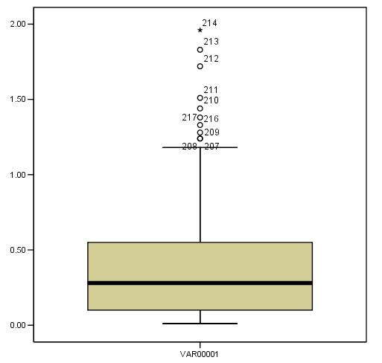
There are outliers in the data
Box plot

Slide 26
Creating designs

Slide 27
Creating Design
Below are two designs of the column data representation of the AIDS data. Which design leads to a chart that is easier to understand?

Slide 28
Creating Design – Best Practices
Avoid 3-D effects
Avoid legends; consider using labels
Avoid contrasting borders around objects
Use annotations to highlight key data changes or to focus on specific data points

Slide 29
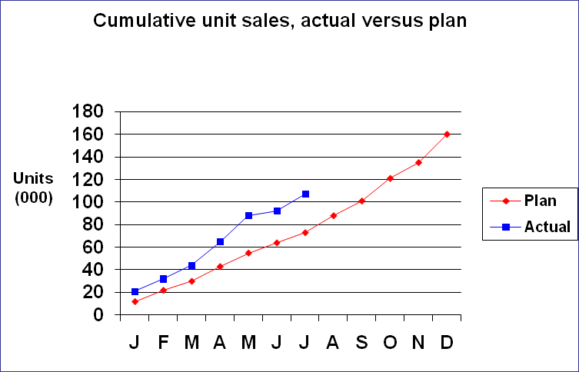
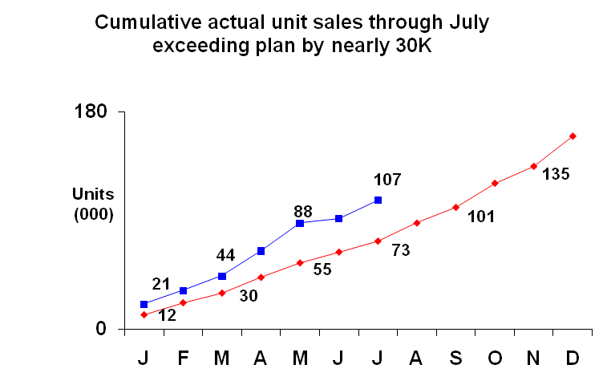
Graphs: Best practices lead to uncluttered look
Design graph to support message; consider using talking head here, too
Use minimal grid lines, ideally none
Use thin lines, thin axes, thin bars, thin arrows to show trends
Display subtle but visible data point marks—only enough to show trend
Use minimal tick marks to display scale: usually just min/max on Y axis
Label axes; label graphic items
Opt for value labels wherever possible; delete some to avoid clutter

Slide 30
Visualization on dashboards
What are data dashboards?
How do you decide what should go on a dashboard? Domain specific?
What are the generic principles?
Do only descriptives go on the dashboard?

Slide 31
Dashboard - Definition
A Visual Display
Of
The most important information needed to achieve one or more objectives
That has been
Consolidated on a Single Screen
So it can be
Monitored and Understood at a glance

Slide 32
Basic Dashboard Design Principle

